Slide 1
If You Want To Travel To Europe after Bootcamp You must see this presentation
By: Aesha Bakheet Aljohani

Slide 2
Analysis Hotels Reviews in Europe (EDA)

Slide 3
Table Of Contents
4
2
1
3
Conclusion
Data Cleaning
Data Extraction
Analysis

Slide 4




Data Extraction
Dataset
Contains 515,000 customer reviews
Dataset
From Kaggle
CSV File
Contains 17 Fields

Slide 5

Data Cleaning

Slide 6
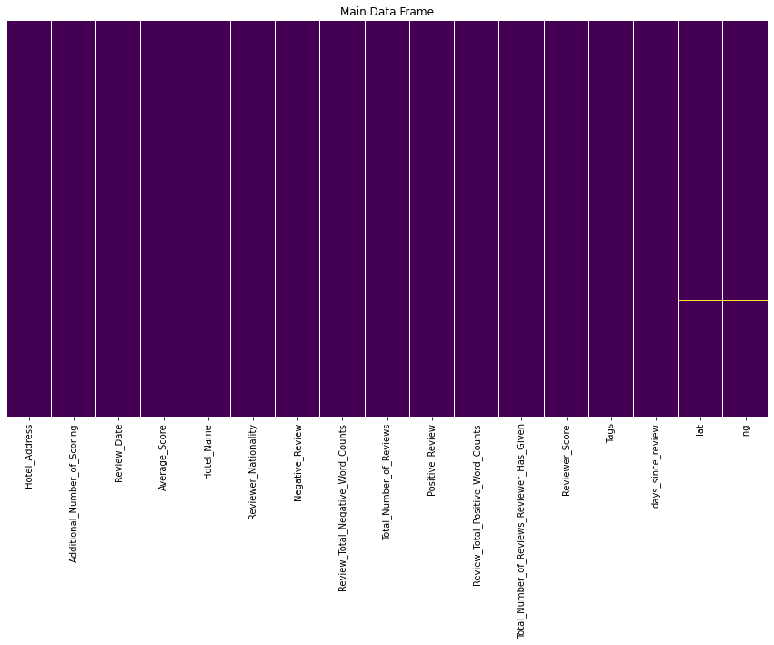
checking the missing value & test dataset

Slide 7
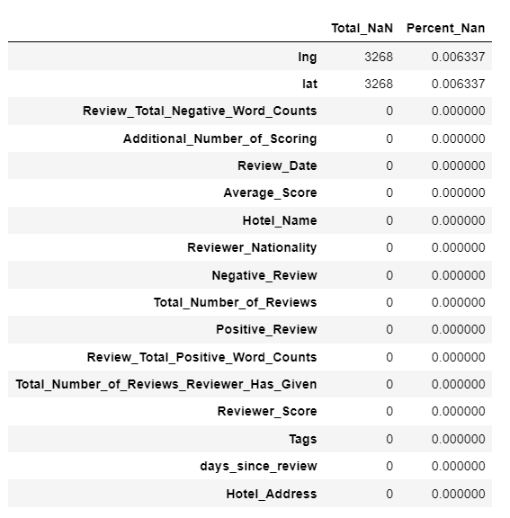
Finding missing data and the percentage of it in each column

Slide 8
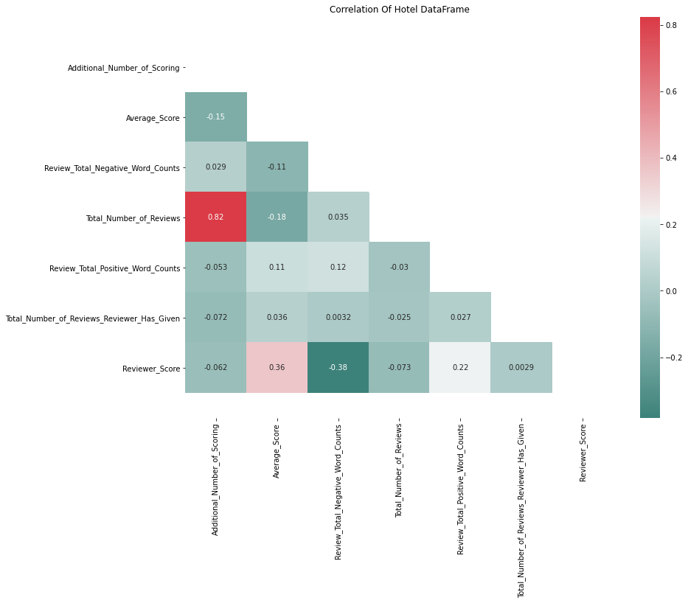
Correlation Of Hotel Data Frame

Slide 9
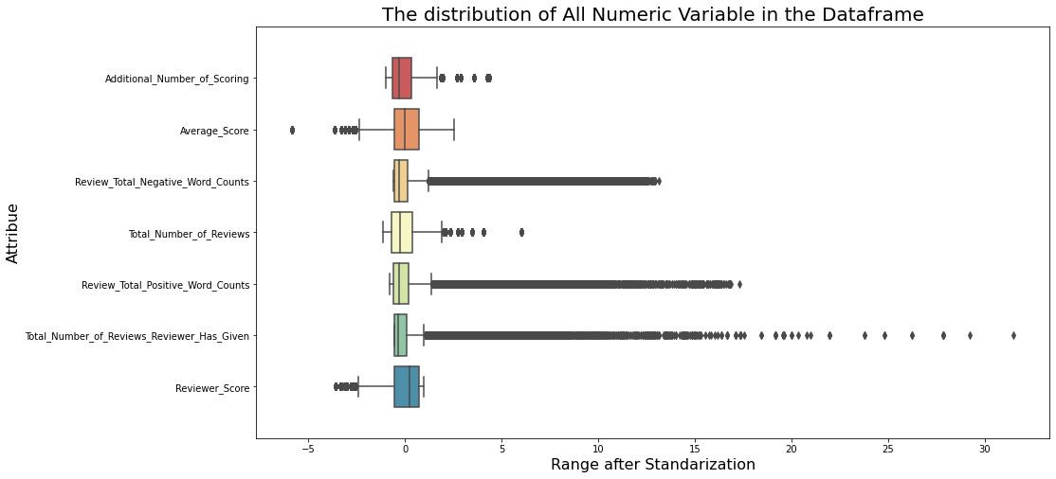
The distribution of All Numeric Variable in the Data frame

Slide 10

Analysis

Slide 11
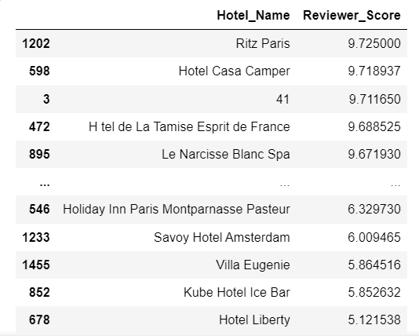
the Average rating of all hotels

Slide 12
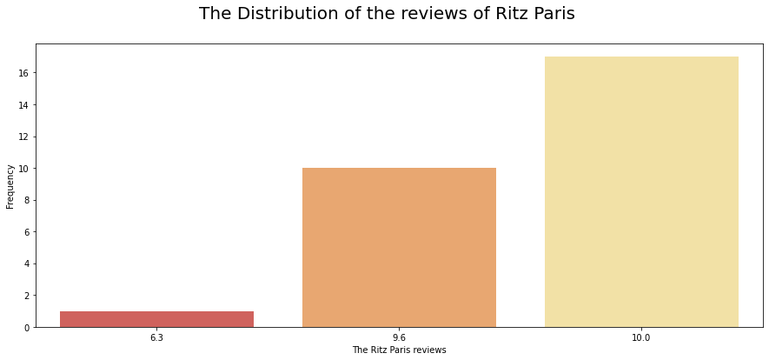
Distribution of reviews to highly rated hotels

Slide 13
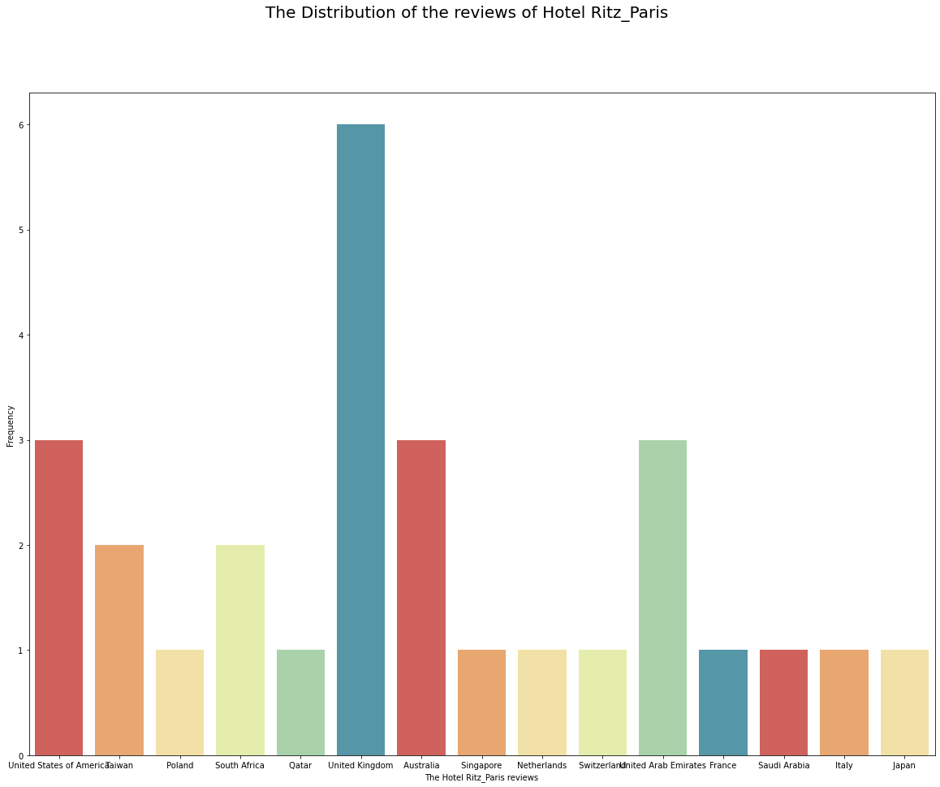
Distribution of reviews to highly rated hotels

Slide 14
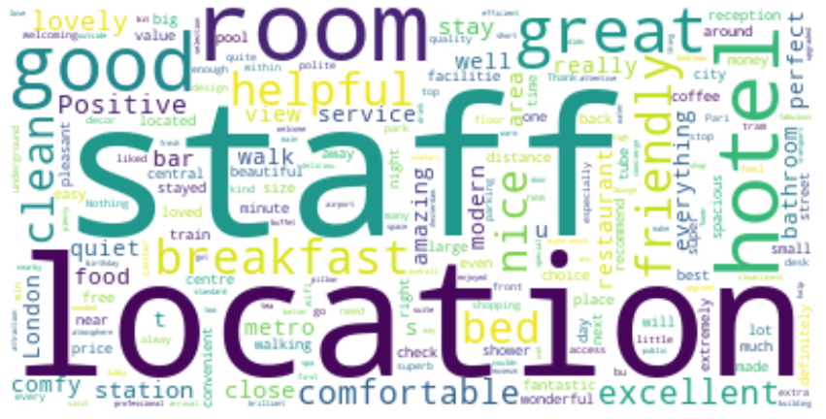
Distribution of reviews to highly rated hotels

Slide 15
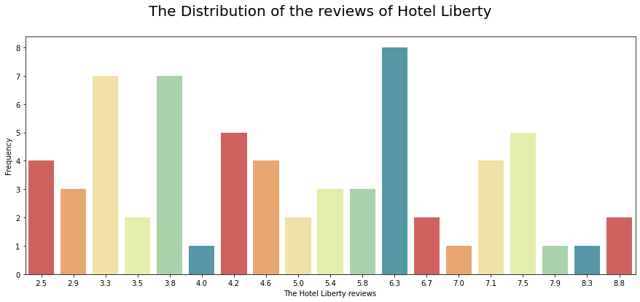
Rating of the worst hotels and Why did it get this rating

Slide 16
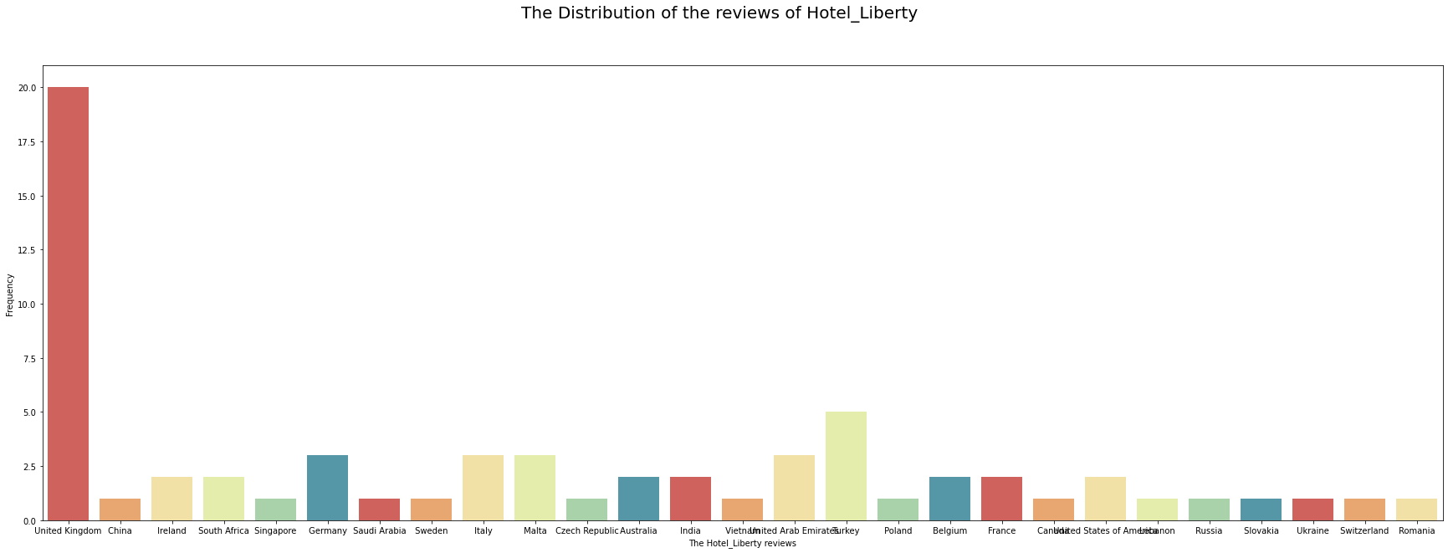
Rating of the worst hotels and Why did it get this rating

Slide 17
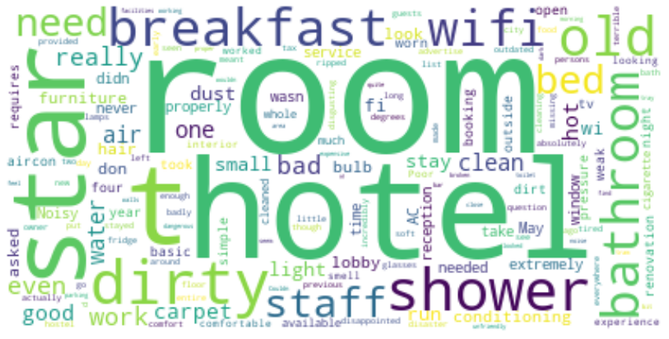
Rating of the worst hotels and Why did it get this rating

Slide 18
Conclusion
After data cleaning and analysis (EDA), we recommend that you choose one of the hotels with high five ratings; for your security, comfort and excellent services.

